Slide 1
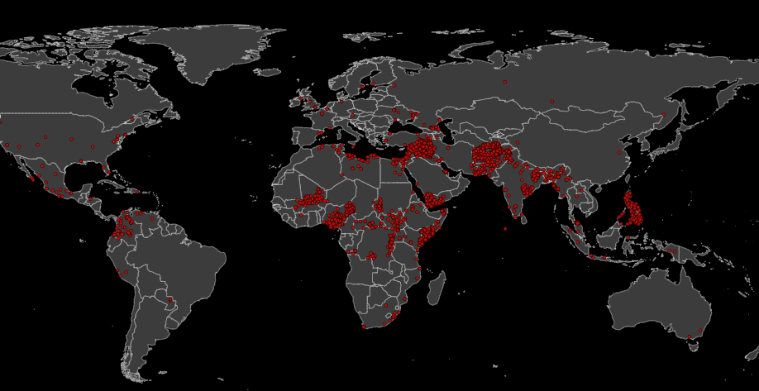
Global Terrorist Attacks
Analyze and explore terroristic attacks occurences, frequencies and relationship through a visual analytics system.
Ludovico Ottobre 1712005, Gianmarco Evangelista 1711818

Slide 2
Introduction and context
In these years we have often heard about terrorism and the consequences it has around the world. Terrorism is, in the broadest sense, the use of intentional violence for political or religious purposes. Wanting to analyze this problem, we have developed a visual analytics tool to allow the user to analyze terrorist attacks in the world from 1970 to 2017. The multiple interactive views of the project provide both low level and high level information and help the user in understanding terrorism events patterns.
Terrorism is a serious problem that affects the whole world. In the recent years we have perceived how even European countries can be victims of attacks. Although strongly rooted in the Middle East, in general this phenomenon is present everywhere.
02/03/21 Visual Analytics, Sapienza Ludovico Ottobre, Gianmarco Evangelista

Slide 3
Introduction and context
Terrorist attacks have always been considered a global problem, bringing death and devastation in cities and countries.
In this project we present Global Terrorism Attack, a visual analysis system for evaluating data with respect to terrorist phenomena around the world. In particular, the system is designed to allow the user to analyze the data of each country for a period of 47 years. In addition to the possibility of having an analysis on a general scale, it is also possible to make comparisons between two different countries and evaluate how they have been victims of terrorism by analyzing the methods of attack, the type of attack and the terrorist group.
Our main goal is to allow the user to obtain information and evaluate how this problem has developed over the years and in which forms it has expressed itself. In order to do this, we have focused our attention on the 5 W’s: who, why, where, when, what.
02/03/21 Visual Analytics, Sapienza Ludovico Ottobre, Gianmarco Evangelista

Slide 4
Dataset and preprocessing
The database, taken on Kaggle at https://www.kaggle.com/START-UMD/gtd, is maintained by researchers at the National Consortium for the Study of Terrorism and Responses to Terrorism (START), headquartered at the University of Maryland. The GTD includes systematic data on domestic as well as international terrorist incidents that have occurred during the period 1970 – 2017, except 1993. We have over a one million of data.
ID event
Year
Month
Day
Place
Region
Region_txt
Provstate
City
Latitude
Longitude
Attack type
Target type
Target subtype
Group name
Weap type
Kills number
02/03/21 Visual Analytics, Sapienza Ludovico Ottobre, Gianmarco Evangelista

Slide 5
Dataset and preprocessing
In order to manage in the right way the dataset, we needed of preprocessing to establish which variables we needed and to remove some events that didn’t give a complete information respect the ones we have used. At the end of the preprocessing we have about 80,000 attacks in fact we have deleted all the attacks with a number of kills equal to zero - it would have been useless for our analysis goal - and all lines with missing data.
Done the basic preprocessing we have used the PCA algorithm, performed on dataset features in order to calculate and store them as two new columns of the dataset:
PCA_Component1: first component computed by PCA algorithm, the one with the highest variance.
PCA_Component2: second component computed by PCA algorithm, the one with the highest variance that is orthogonal to the first, so it is linearly uncorrelated with it.
02/03/21 Visual Analytics, Sapienza Ludovico Ottobre, Gianmarco Evangelista

Slide 6
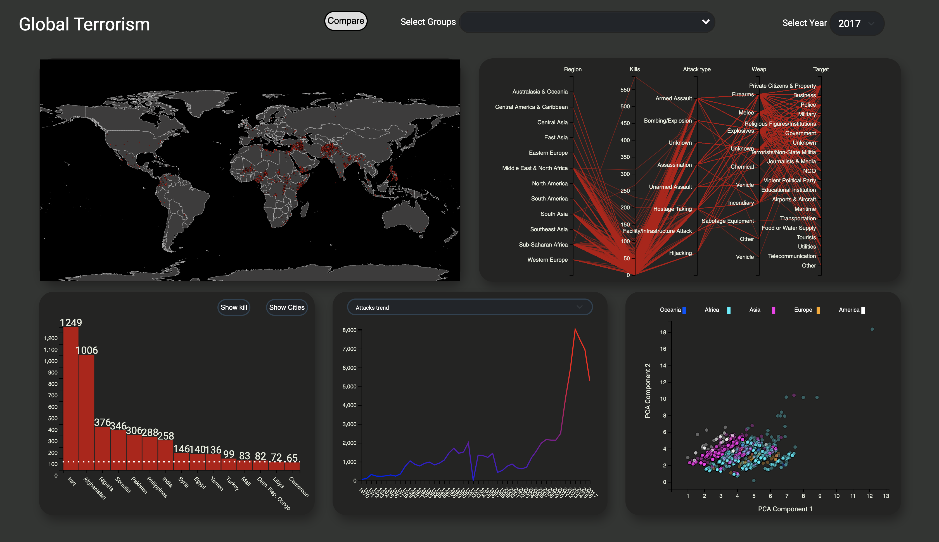
Overview
Different views are used in this project to build a complete tool for analyzing terrorist attacks.
Those views are built using D3.js and exposes a wide of information.
Starting the project, this overview appears to the users: they can explore the map, read the frequencies of attacks and deaths through the bar, analyze different trends with the line chart, filtering the parallel coordinates chart and use the scatterplot in order see how data are distributed according to the first two PCA components.
02/03/21 Visual Analytics, Sapienza Ludovico Ottobre, Gianmarco Evangelista

Slide 7
Visualization: Geographic map
The map graph offers a clear visualization of the attack events over the different countries in which those events took place.
It helps the users giving them the position of the events which otherwise is hard to get it.
Each event is represented by a circle on the map.
02/03/21 Visual Analytics, Sapienza Ludovico Ottobre, Gianmarco Evangelista

Slide 8
Visualization: Parallel graph
The main view of the project is the Parallel Graph.
This graph raffigures the different dimensions of the dataset in a single plot.
Each line in the graph represents a single event.
Each vertical bar represents a variable and has its own scale.
02/03/21 Visual Analytics, Sapienza Ludovico Ottobre, Gianmarco Evangelista

Slide 9
Visualization: Bar chart
The bar chart shows the top 15 countries ranked by the number of terrorist attack events that occurred inside their borders.
The dashed line represents the mean value and it was calculated in order to give to the user a visual comparison with the selected trend.
02/03/21 Visual Analytics, Sapienza Ludovico Ottobre, Gianmarco Evangelista

Slide 10
Visualization: Graphs
Line chart, bar chart and box plot are available in order to make a focus on a global/country trend about attacks and kills and about groups.
Kills and attacks trend are computed over a period of 47 years.
Box plot is used to analyze the kills distribution in the selected place.
The colors chosen follow the trend of the line, in fact warmer colors have been chosen to identify the peaks.
02/03/21 Visual Analytics, Sapienza Ludovico Ottobre, Gianmarco Evangelista

Slide 11
Visualization: Scatter plot
Scatterplot displays each element of the dataset according to the first two PCA components, helping to point out outliers and clusters.
In order to add more information on the graph, we added a chromatic encoding of the points representing the region in which the event happened.
By observing this chart the user can find similarities over the events looking at the distance between the points and searching for clusters.
02/03/21 Visual Analytics, Sapienza Ludovico Ottobre, Gianmarco Evangelista

Slide 12
Why this approach?
Parallel chart’s filters provides a fine-grained selection on the events in the dataset.
The header with the checkboxes let the user select macro ranges for the analysis.
Scatterplot and parallel help in identifying outliers while the map provide a easy to ready location.
Bar chart and line chart, offer a high-level information about the terrorist attack events.
02/03/21 Visual Analytics, Sapienza Ludovico Ottobre, Gianmarco Evangelista

Slide 13
Links
Project website: https://ottobreludovico.github.io/VAProject/
Detailed article: https://github.com/ottobreludovico/VAProject/blob/main/docs/GlobalTerrorism.pdf
02/03/21 Visual Analytics, Sapienza Ludovico Ottobre, Gianmarco Evangelista

